Slide 1
The Four Stages of Analytics
Each Provide Different Benefits

Slide 2
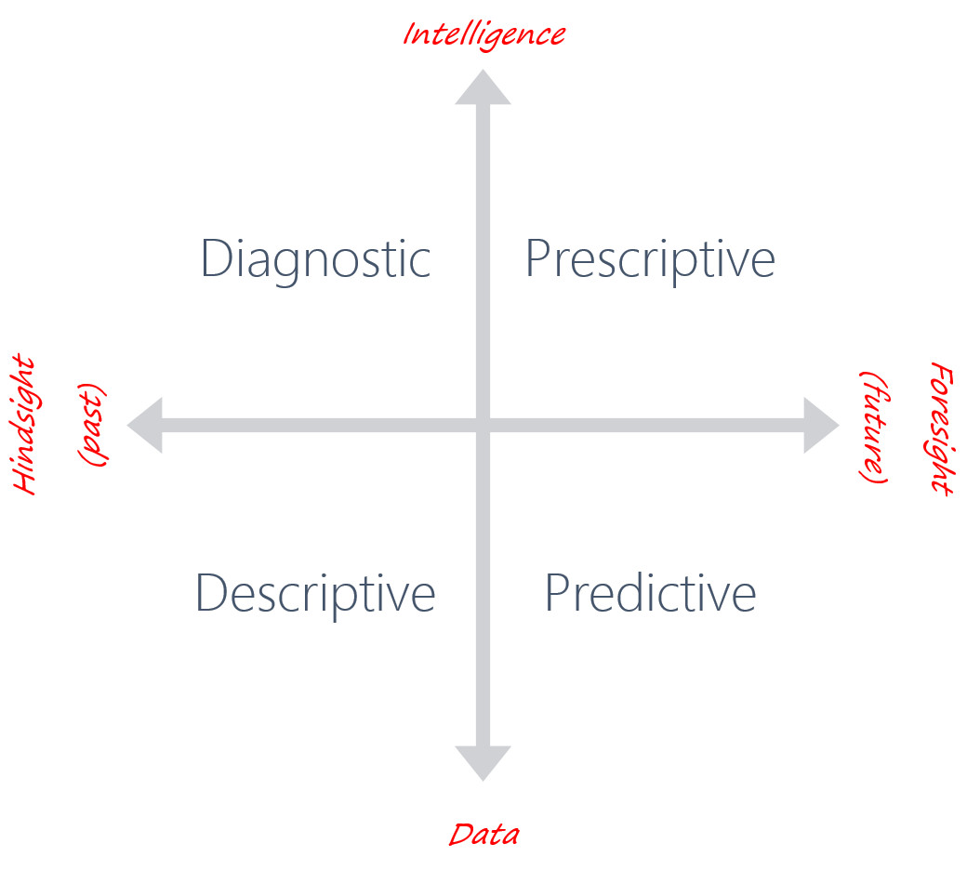

Slide 3
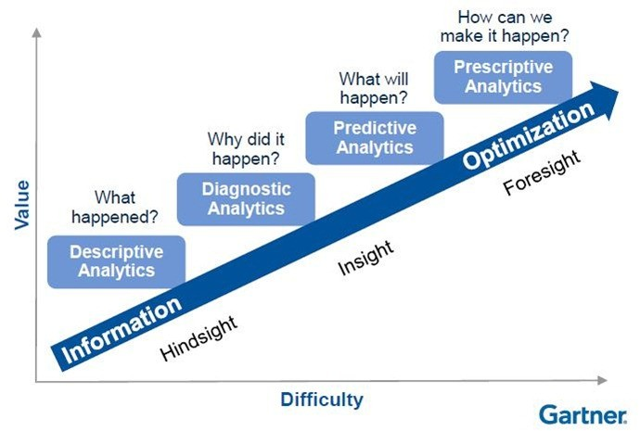

Slide 4
Descriptive – This is the simplest stage of analytics in which historic data is analyzed to identify ‘what happened.’ Events of interest can be identified and the data can be aggregated to identify the events that occur the most.
Example: The engine warning light has illuminated on the dashboard of a car. We could use the historic data for the use of the car, where driven, for how long, any maintenance that has been recently performed and create views (charts and graphs) of the information to show what happened to the car leading up to the point the light came on.

Slide 5
Diagnostic – At this stage deeper levels of analysis are required, usually involving subject matter experts in the domain. This is so we can determine ‘why it happened’ or the root-cause of an event or failure.
Example: We can use the historic data mixed with domain experience to identify what has caused the engine warning light to come on. This could be automated into a message to state the cause of failure to the driver.

Slide 6
Predictive – In this stage the complexity jumps. In order to predict future events, mathematical models are required. These require multiple iterations of development. This is in turn followed by refinement and testing to get the models to the required level of accuracy, which is dependent on the needs of the customer.
Example: We can use batches or a continuous feed of data from the car to predict the next time the engine warning light is going to come on. This could result in a message to the driver to tell them to take their car to a mechanic within a number of miles.

Slide 7
Prescriptive – At this stage we develop complex models of a device or system and its sub-components. The resultant model will provide insight into all favorable outcomes and suggest courses of action by which they can be achieved.
Example: We can use batches or a continuous feed of data from the car to recommend the maintenance or part replacements that should be made to prevent the engine warning light from coming on.

Slide 8
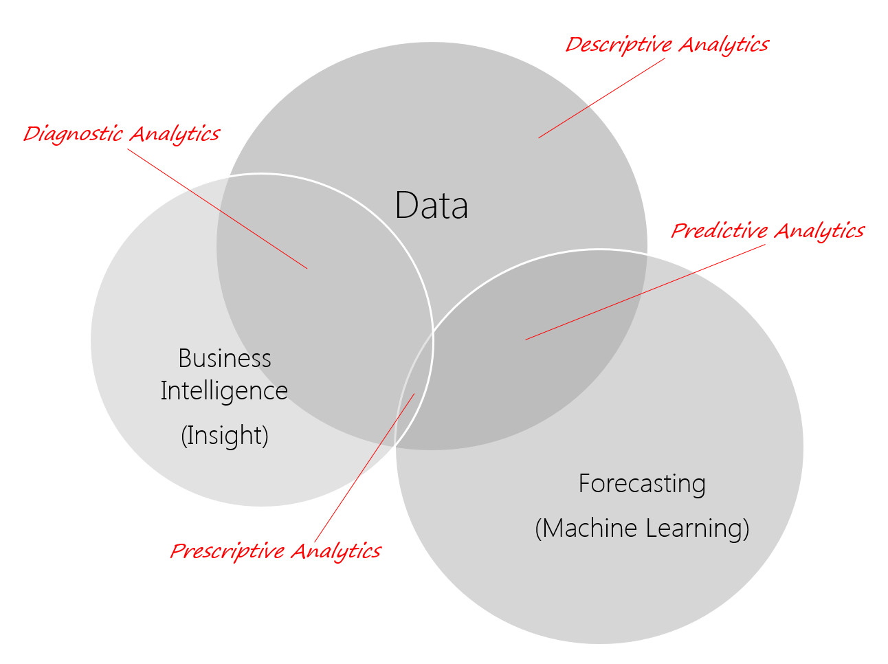

Slide 9
Although the stages illustrated above seem like a progression, moving from one stage to the next, this is not strictly true. It is entirely possible to jump straight to a prediction of events without knowledge of why they occur. However, the data gathered at the descriptive stage is still required as a basis for modeling.
Most companies are already performing some level of descriptive analytics where the biggest hurdle is usually gathering all of the available data. Following that aggregation, trending and visualizations of the data can be conducted in tools such as Microsoft Excel or Tableau.

Slide 10


